Slide 1
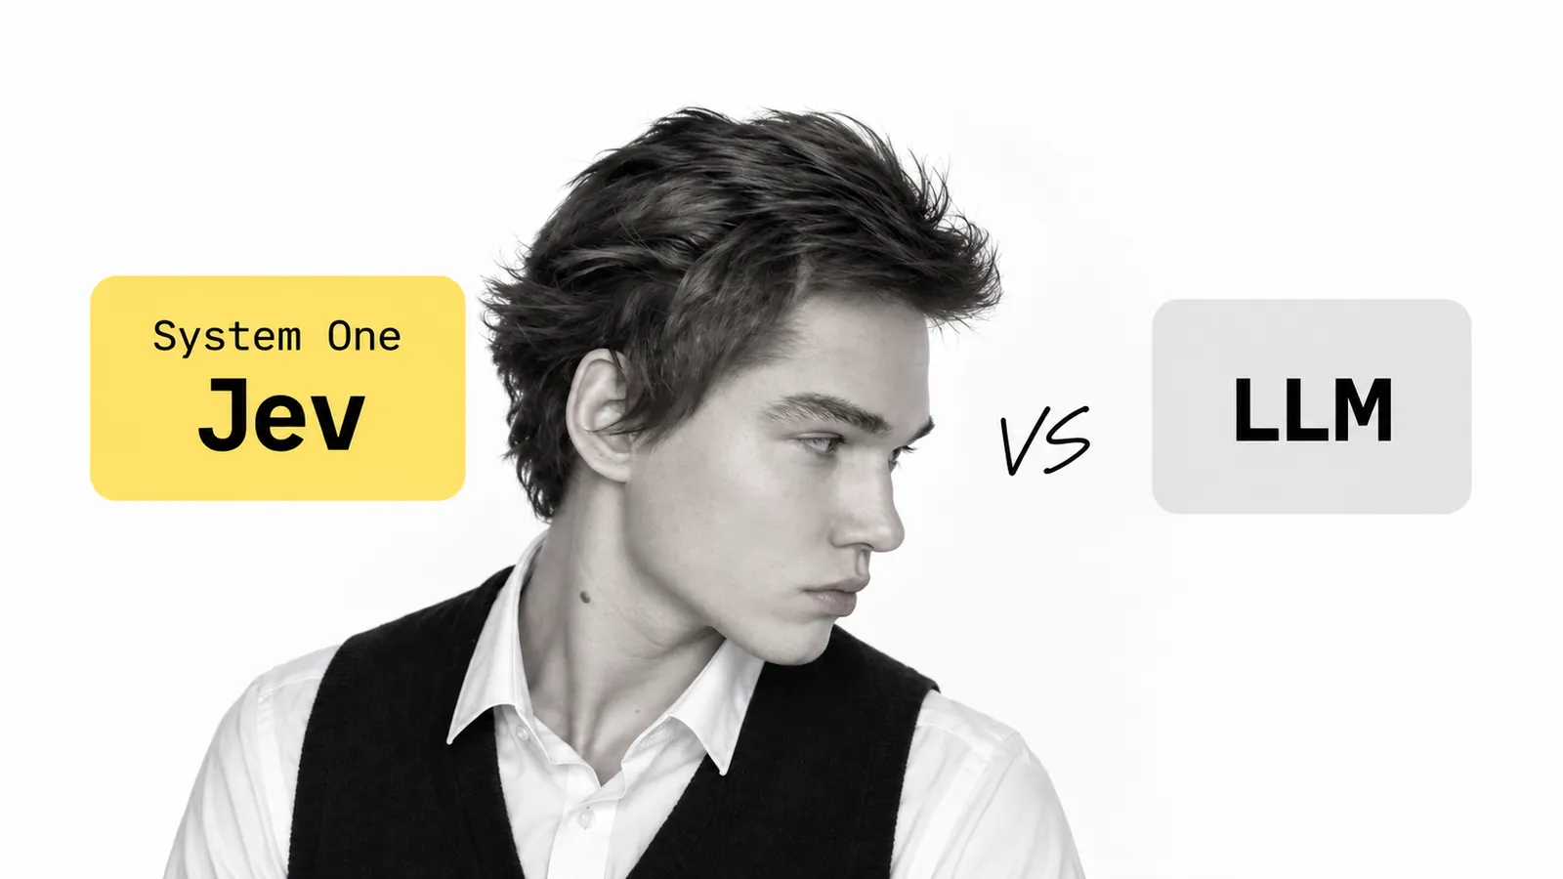
NEXT BIG THING IN AI - SYSTEM ONE
Viktor Zaika

Slide 2
01 / WHAT CHANGED
A decision model does one job.
A generative LLM
Jev / System One
Generates text. Great for explanations, writing, transformations and summaries.
Receives state and a bounded question. Returns a choice, score or yes/no probability.
The code around the model decides what to do with the answer.
Viktor Zaika · System One
02
Notes:
Source: https://typesafe.ai/blog/introducing-system-one-models-and-jev

Slide 3
02 / A PRODUCT ARCHITECTURE
Use it where the output is tiny.
Incoming request
Jev decision
Cheap route / LLM / person
→
→
Example: “Is this suspicious?” → only escalate when it deserves more attention.
The model chooses. Your application still owns thresholds, permissions and fallbacks.
Viktor Zaika · System One
03
Notes:
TypeSafe: https://typesafe.ai/blog/introducing-system-one-models-and-jev
Liquid: https://docs.liquid.ai/lfm/models/decision-models

Slide 4
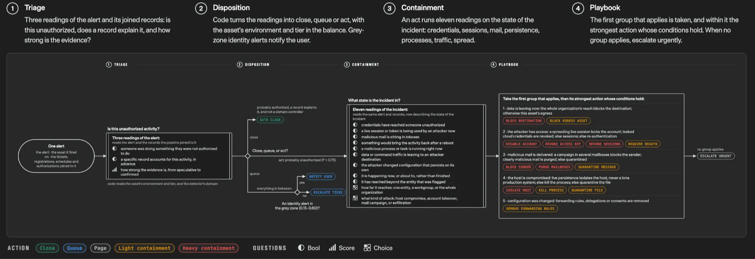
03 / TYPESAFE EXAMPLE
This is what a real workflow looks like.
Alert → triage → disposition → containment → playbook
Source: TypeSafe company diagram ↗
Viktor Zaika · System One
04
Notes:
This is a TypeSafe illustration, not independent evaluation. Original: https://typesafe.ai/blog/introducing-system-one-models-and-jev

Slide 5
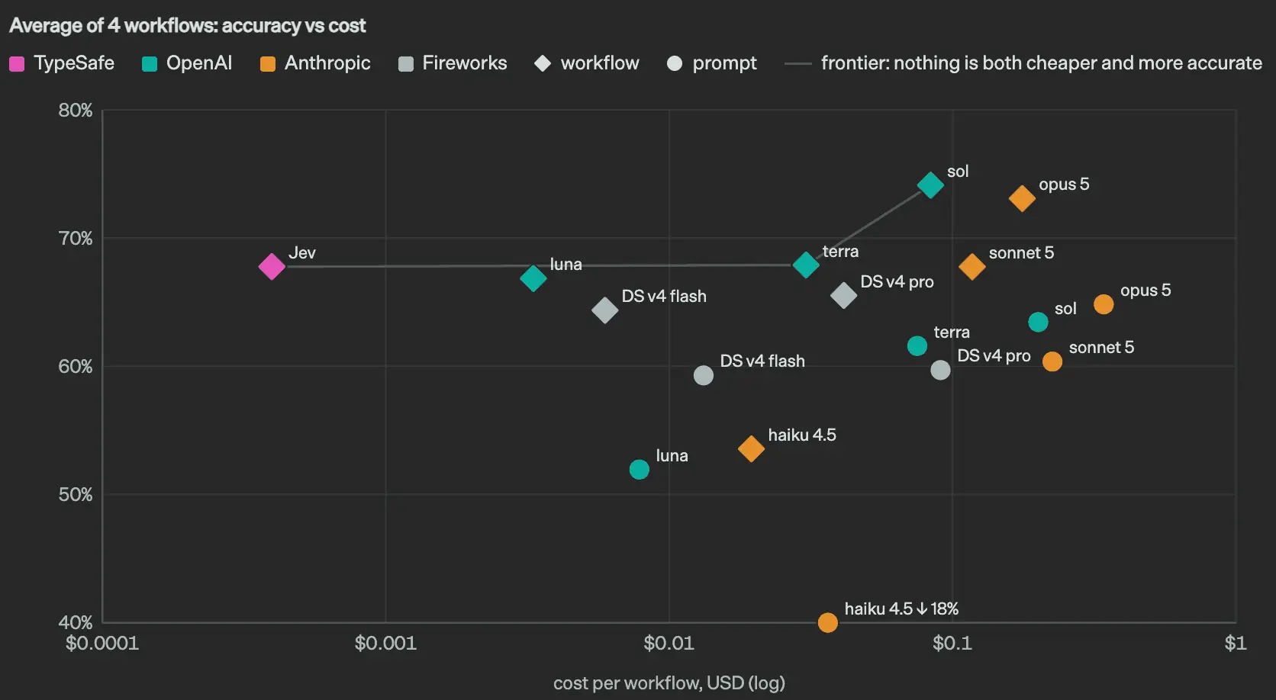
04 / EVIDENCE, WITH CAVEATS
The early performance signal is interesting.
Company eval
Four TypeSafe-selected workflows. Read the methodology before using the comparison as a benchmark.
User anecdote
One Reddit user reported moving a 3–6-second check to milliseconds. It is not controlled testing.
Viktor Zaika · System One
05
Notes:
TypeSafe evaluation: https://typesafe.ai/blog/introducing-system-one-models-and-jev
Reddit report: https://www.reddit.com/r/ArtificialInteligence/comments/1wkhsyh/jev_typesafeai_is_revolutionary_as_llms/

Slide 6
05 / A PRACTICAL FIRST TEST
Find one decision worth replacing.
01
Find a repeated LLM call
Look for final outputs like true, “sales” or 0.83.
02
Define the decision
Name the allowed choices, a score rubric or a yes/no gate.
03
Measure on your own data
Compare latency, cost and mistakes. Keep an uncertain route.
TypeSafe ↗
Liquid docs ↗
Hugging Face community ↗
Viktor Zaika · System One
06
Notes:
The full article is at zaika.pro/blog/next-big-thing-in-ai-system-one/. TypeSafe: https://typesafe.ai/blog/introducing-system-one-models-and-jev
Liquid: https://docs.liquid.ai/lfm/models/decision-models
Reddit: https://www.reddit.com/r/ArtificialInteligence/comments/1wkhsyh/jev_typesafeai_is_revolutionary_as_llms/
Hugging Face community: https://huggingface.co/blog/dddffgassa/jev-ai

