Slide 1
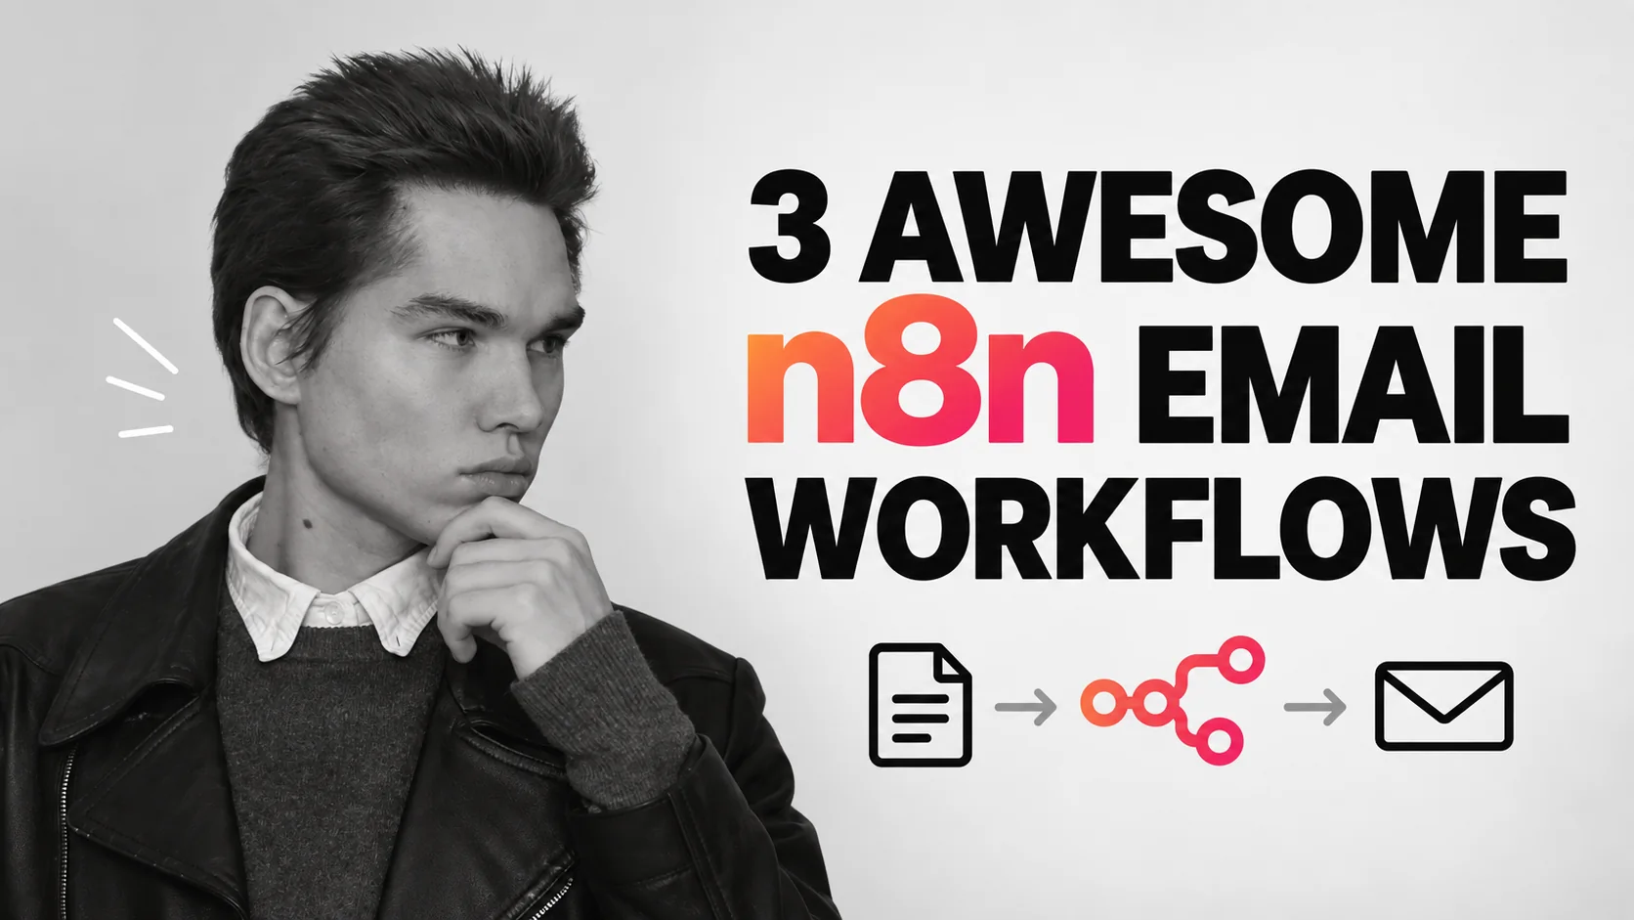
Viktor Zaika

Slide 2
Escolha o trabalho
O que deve acontecer com o e- mail?
01
02
03
Muitos e-mails entrantes
Verificando a caixa de entrada com muita frequência
Documentos enterrados nas mensagens
→
→
→
Ordenar por categoria e preparar rascunhos
Obter um digestivo diário priorizado
Armazene PDFs e indexe seus campos
Viktor Zaika
02

Slide 3
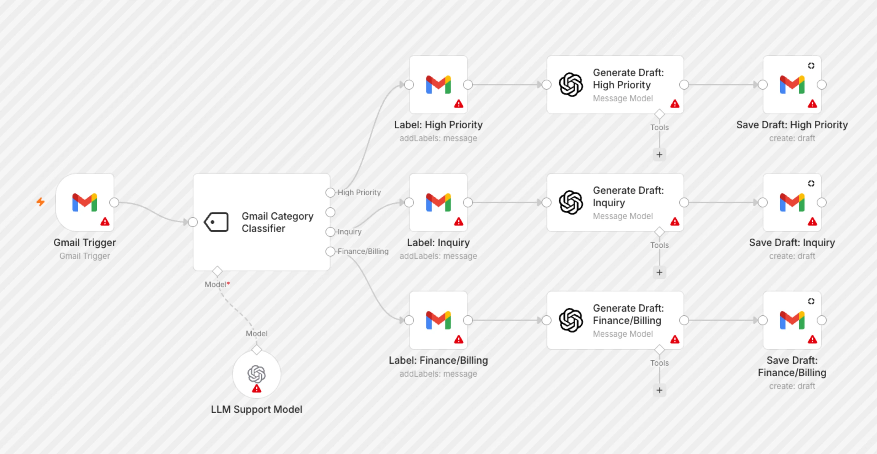
01 / REAL TEMPLATO N8N
Ordenar e-mails e esboçar respostas
Gmail → classificar → rótulo → rascunho
Modelo n8n de resolução completa por Supira Inc. ї
Viktor Zaika
03
Notes:
A classifier chooses a category. The Switch routes it to a label and, where appropriate, a draft. You review before sending.
Notice the separate label and draft branches. Red warning triangles indicate credentials to configure.
https://n8n.io/workflows/8426-gmail-email-classifier-with-gpt-4-auto-generated-draft-replies/
Use this prompt for sorting emails and drafting replies:
Analyze this incoming email.
Return ONLY valid JSON:
{
"category": "urgent | sales | support | invoice | newsletter | personal | ignore",
"priority": "high | medium | low",
"needs_reply": true,
"summary": "one short sentence",
"draft_reply": "reply text or null"
}
Rules:
Use "urgent" only when there is a clear deadline, serious problem or something blocking work.
Use "invoice" for invoices, payment requests, receipts and billing-related emails.
Use "newsletter" for promotional or mass-distributed content.
Set needs_reply to false for newsletters, receipts, automated notifications and emails that do not expect a response.
If a reply is needed, write a short natural reply matching the sender's tone.
Do not invent prices, dates, promises or facts.
If information is missing, write [NEEDS INPUT] inside the draft.

Slide 4
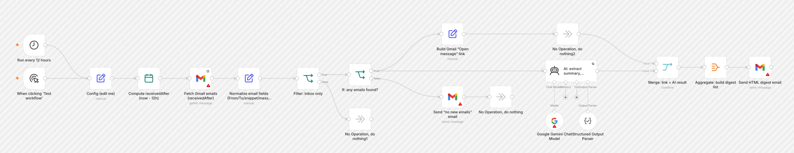
02 / REAL TEMPLATO N8N
Obter um digest de e-mail útil
Programação → e-mail recente → IA → digerir
Template n8n de resolução completa por Mohammed Aljer
Viktor Zaika
04
Notes:
A schedule collects recent messages. AI identifies the few that need attention, then one digest links back to the originals.
The real template has extra routes for an empty inbox and for building direct links to messages.
https://n8n.io/workflows/13126-summarize-gmail-emails-with-gemini-and-send-an-html-action-digest/
Use this prompt for creating an actionable digest:
Create a short actionable digest from these emails.
Group them into:
1. URGENT
2. NEEDS REPLY
3. ACTION REQUIRED
4. FYI
5. NEWSLETTERS / PROMOTIONS
For each important email return:
{
"sender": "",
"subject": "",
"summary": "",
"action": "",
"priority": "high | medium | low"
}
Rules:
Keep summaries to one sentence.
Extract concrete actions when possible.
Include deadlines only when explicitly mentioned.
Do not include routine automated notifications unless they contain an error, payment problem, security warning or other issue requiring attention.
For newsletters and promotions, only return the total count unless something looks unusually relevant.
Sort important emails by priority.

Slide 5
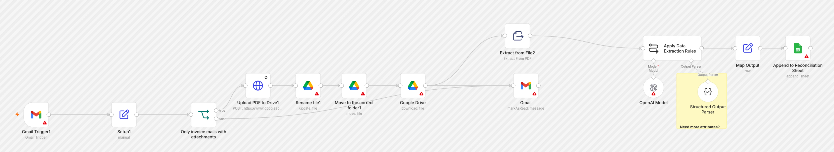
03 / REAL TEMPLADO N8N
Processar faturas e anexos
Gmail → PDF → extração → Drive + Folhas
Modelo n8n de resolução completa por Juan Carlos Cavero Gracia ї
Viktor Zaika
05
Notes:
The PDF goes to Drive. Extracted fields and the Drive link go to Sheets, so the original file and searchable data stay together.
Follow the original attachment into Drive, then the extraction path into a Sheets row.
https://n8n.io/workflows/3016-invoices-from-gmail-to-drive-and-google-sheets/
Use this prompt for extracting attachment details:
Analyze this email and attached document.
Return ONLY valid JSON:
{
"document_type": "invoice | receipt | contract | report | other",
"company": "",
"invoice_number": "",
"invoice_date": "",
"due_date": "",
"currency": "",
"amount": null,
"description": "",
"suggested_filename": ""
}
Rules:
Never guess missing values.
Use null when a value cannot be found.
Dates should use YYYY-MM-DD.
Amount must contain numbers only.
suggested_filename format:
YYYY-MM-DD_Company_DocumentType_InvoiceNumber.pdf
Remove characters that are unsafe in filenames.

Slide 6
ANTES DE ATIVAR
Teste primeiro com um pequeno lote.
01
Credenciais
Conecte Gmail, IA e qualquer Conta de Unidade ou Folhas.
02
Forma dos dados
Verifique os campos JSON e Troque rotas.
03
Revisão humana
Leia rascunhos e verifique os montantes da fatura antes de agir.
Os prompts completos estão nas notas de slides relevantes e no PDF do companheiro.
Viktor Zaika
06

