Slide 1
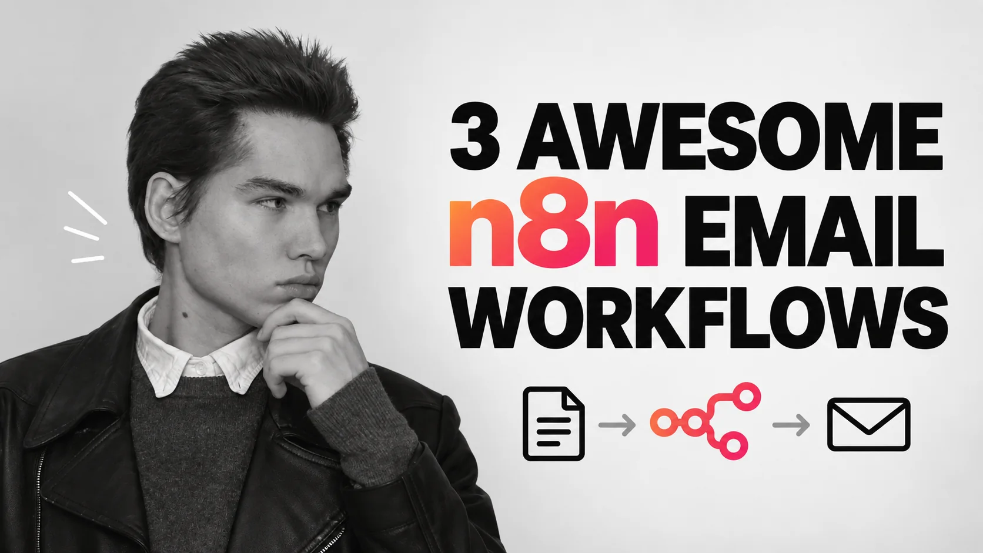
Viktor Zaika

Slide 2
CHOISISSEZ LE TRAVAIL
Que faut-il faire de cet e-mail ?
01
02
03
Trop d'e-mails entrants
Vérifier la boîte de réception trop souvent
Des documents enfouis dans les messages
→
→
→
Trier par catégorie et préparer des brouillons
Obtenez un résumé quotidien prioritaire
Stockez les PDF et indexez leurs champs
Viktor Zaika
02

Slide 3
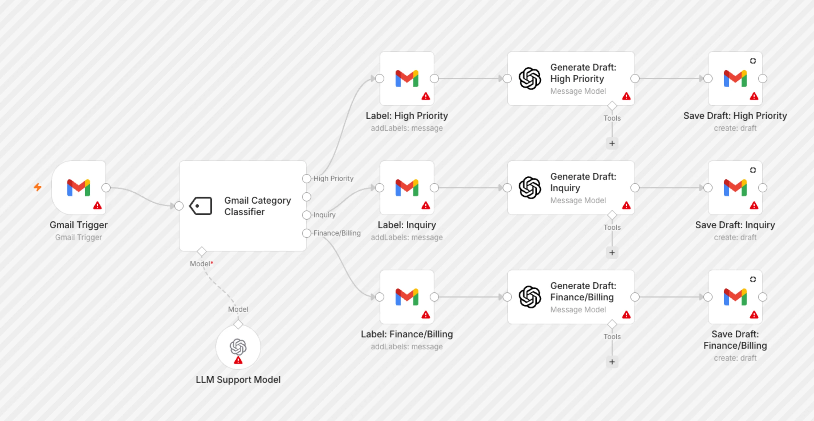
01 / MODÈLE n8n RÉEL
Trier les e-mails et les brouillons de réponses
Gmail → classer → étiquette → brouillon
Modèle n8n pleine résolution par Supira Inc. ↗
Viktor Zaika
03
Notes:
A classifier chooses a category. The Switch routes it to a label and, where appropriate, a draft. You review before sending.
Notice the separate label and draft branches. Red warning triangles indicate credentials to configure.
https://n8n.io/workflows/8426-gmail-email-classifier-with-gpt-4-auto-generated-draft-replies/
Use this prompt for sorting emails and drafting replies:
Analyze this incoming email.
Return ONLY valid JSON:
{
"category": "urgent | sales | support | invoice | newsletter | personal | ignore",
"priority": "high | medium | low",
"needs_reply": true,
"summary": "one short sentence",
"draft_reply": "reply text or null"
}
Rules:
Use "urgent" only when there is a clear deadline, serious problem or something blocking work.
Use "invoice" for invoices, payment requests, receipts and billing-related emails.
Use "newsletter" for promotional or mass-distributed content.
Set needs_reply to false for newsletters, receipts, automated notifications and emails that do not expect a response.
If a reply is needed, write a short natural reply matching the sender's tone.
Do not invent prices, dates, promises or facts.
If information is missing, write [NEEDS INPUT] inside the draft.

Slide 4
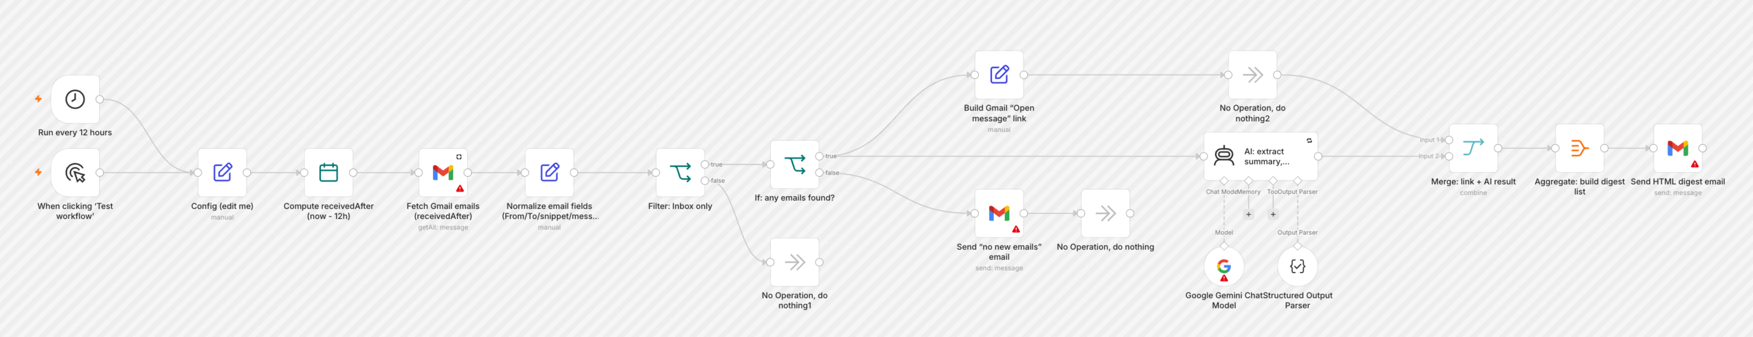
02 / MODÈLE n8n RÉEL
Recevez un résumé utile par e-mail
Calendrier → e-mail récent → IA → résumé
Modèle n8n pleine résolution par Mohammed Aljer ↗
Viktor Zaika
04
Notes:
A schedule collects recent messages. AI identifies the few that need attention, then one digest links back to the originals.
The real template has extra routes for an empty inbox and for building direct links to messages.
https://n8n.io/workflows/13126-summarize-gmail-emails-with-gemini-and-send-an-html-action-digest/
Use this prompt for creating an actionable digest:
Create a short actionable digest from these emails.
Group them into:
1. URGENT
2. NEEDS REPLY
3. ACTION REQUIRED
4. FYI
5. NEWSLETTERS / PROMOTIONS
For each important email return:
{
"sender": "",
"subject": "",
"summary": "",
"action": "",
"priority": "high | medium | low"
}
Rules:
Keep summaries to one sentence.
Extract concrete actions when possible.
Include deadlines only when explicitly mentioned.
Do not include routine automated notifications unless they contain an error, payment problem, security warning or other issue requiring attention.
For newsletters and promotions, only return the total count unless something looks unusually relevant.
Sort important emails by priority.

Slide 5
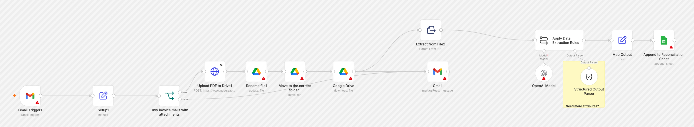
03 / MODÈLE n8n RÉEL
Traiter les factures et les pièces jointes
Gmail → PDF → extraction → Lecteur + Feuilles
Modèle n8n pleine résolution par Juan Carlos Cavero Gracia ↗
Viktor Zaika
05
Notes:
The PDF goes to Drive. Extracted fields and the Drive link go to Sheets, so the original file and searchable data stay together.
Follow the original attachment into Drive, then the extraction path into a Sheets row.
https://n8n.io/workflows/3016-invoices-from-gmail-to-drive-and-google-sheets/
Use this prompt for extracting attachment details:
Analyze this email and attached document.
Return ONLY valid JSON:
{
"document_type": "invoice | receipt | contract | report | other",
"company": "",
"invoice_number": "",
"invoice_date": "",
"due_date": "",
"currency": "",
"amount": null,
"description": "",
"suggested_filename": ""
}
Rules:
Never guess missing values.
Use null when a value cannot be found.
Dates should use YYYY-MM-DD.
Amount must contain numbers only.
suggested_filename format:
YYYY-MM-DD_Company_DocumentType_InvoiceNumber.pdf
Remove characters that are unsafe in filenames.

Slide 6
AVANT D'ACTIVER
Testez d'abord avec un petit lot.
01
Informations d'identification
Connectez Gmail, AI et tous les comptes Drive ou Sheets.
02
Forme des données
Vérifiez les champs JSON et les routes Switch.
03
Examen humain
Lisez les brouillons et vérifiez les montants des factures avant d’agir.
Les prompts complets se trouvent dans les notes des diapositives correspondantes et dans le PDF joint.
Viktor Zaika
06

