Slide 1
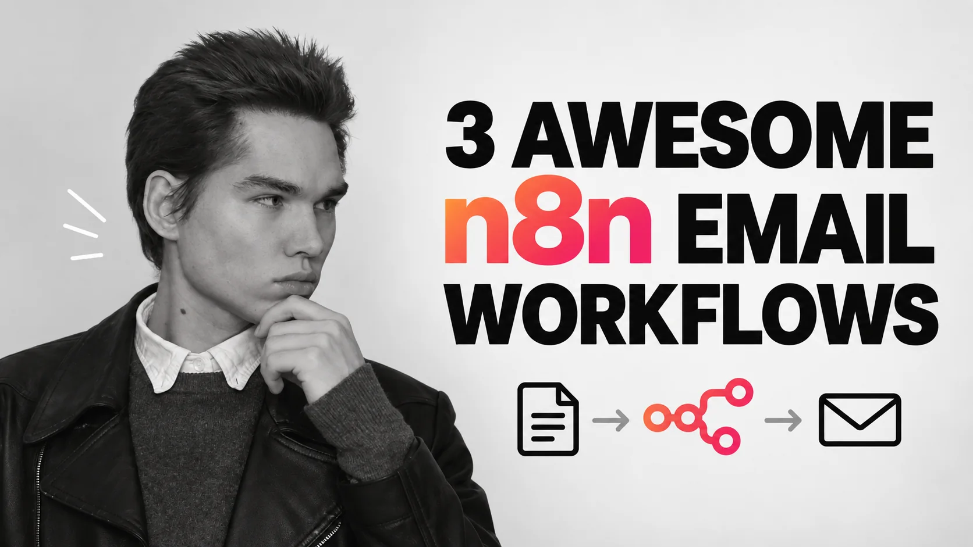
Viktor Zaika

Slide 2
Escoja el trabajo
¿Qué debería pasar con el correo electrónico?
01
02
03
Demasiados correos electrónicos entrantes
Revisando la bandeja de entrada con demasiada frecuencia
Documentos enterrados en mensajes
→
→
→
Ordenar por categoría y preparar borradores
Obtener un digest diario priorizado
Almacenar PDFs e indexar sus campos
Viktor Zaika
02

Slide 3
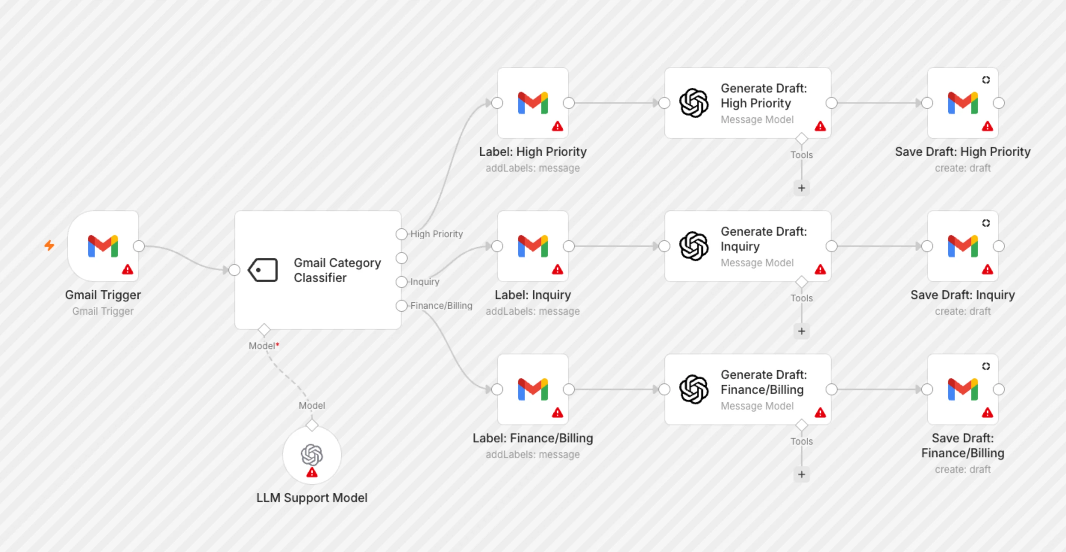
01 / TEMPLADO N8N REAL
Ordenar correos electrónicos y respuestas de borrador
Gmail → clasificar → etiqueta → borrador
Plantilla de resolución completa n8n por Supira Inc.
Viktor Zaika
03
Notes:
A classifier chooses a category. The Switch routes it to a label and, where appropriate, a draft. You review before sending.
Notice the separate label and draft branches. Red warning triangles indicate credentials to configure.
https://n8n.io/workflows/8426-gmail-email-classifier-with-gpt-4-auto-generated-draft-replies/
Use this prompt for sorting emails and drafting replies:
Analyze this incoming email.
Return ONLY valid JSON:
{
"category": "urgent | sales | support | invoice | newsletter | personal | ignore",
"priority": "high | medium | low",
"needs_reply": true,
"summary": "one short sentence",
"draft_reply": "reply text or null"
}
Rules:
Use "urgent" only when there is a clear deadline, serious problem or something blocking work.
Use "invoice" for invoices, payment requests, receipts and billing-related emails.
Use "newsletter" for promotional or mass-distributed content.
Set needs_reply to false for newsletters, receipts, automated notifications and emails that do not expect a response.
If a reply is needed, write a short natural reply matching the sender's tone.
Do not invent prices, dates, promises or facts.
If information is missing, write [NEEDS INPUT] inside the draft.

Slide 4
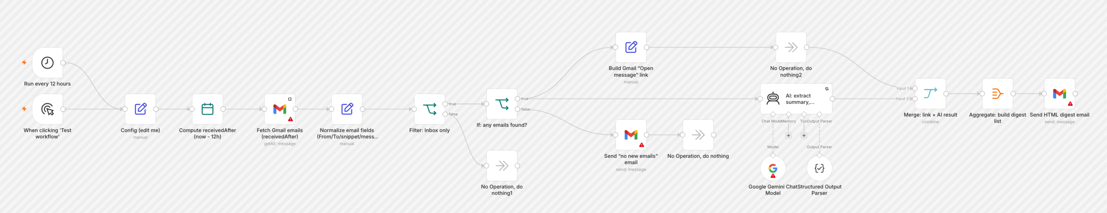
02 / TEMPLADO N8N REAL
Obtener un útil resumen de correo electrónico
Programar → correo electrónico reciente → AI → digest
Plantilla de resolución completa n8n por Mohammed Aljer
Viktor Zaika
04
Notes:
A schedule collects recent messages. AI identifies the few that need attention, then one digest links back to the originals.
The real template has extra routes for an empty inbox and for building direct links to messages.
https://n8n.io/workflows/13126-summarize-gmail-emails-with-gemini-and-send-an-html-action-digest/
Use this prompt for creating an actionable digest:
Create a short actionable digest from these emails.
Group them into:
1. URGENT
2. NEEDS REPLY
3. ACTION REQUIRED
4. FYI
5. NEWSLETTERS / PROMOTIONS
For each important email return:
{
"sender": "",
"subject": "",
"summary": "",
"action": "",
"priority": "high | medium | low"
}
Rules:
Keep summaries to one sentence.
Extract concrete actions when possible.
Include deadlines only when explicitly mentioned.
Do not include routine automated notifications unless they contain an error, payment problem, security warning or other issue requiring attention.
For newsletters and promotions, only return the total count unless something looks unusually relevant.
Sort important emails by priority.

Slide 5
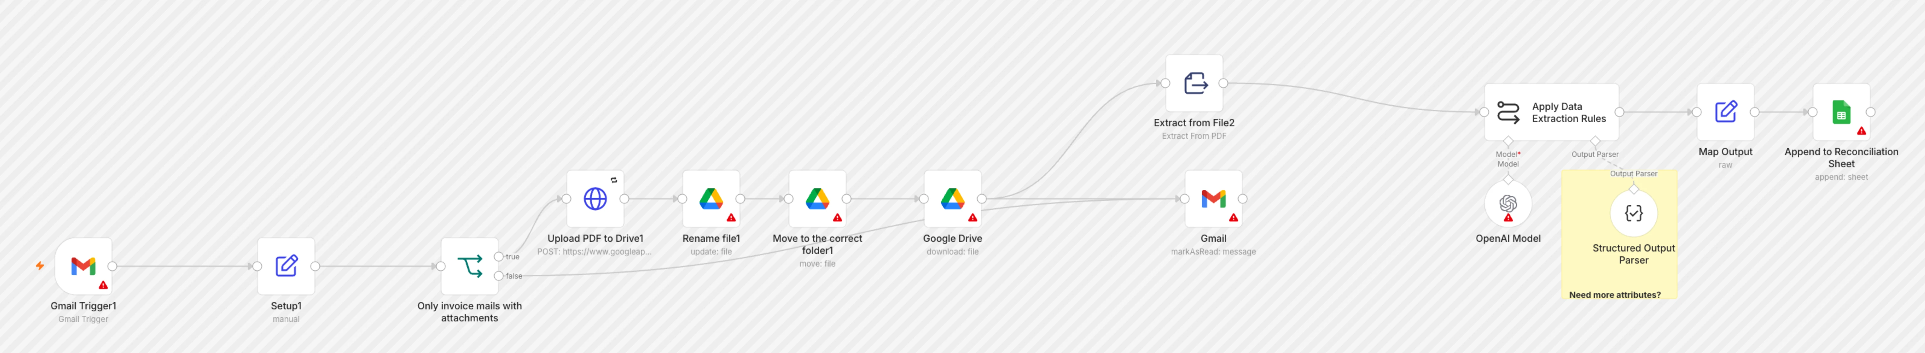
03 / TEMPLADO N8N REAL
Facturas de proceso y anexos
Gmail → PDF → extracción → Drive + Hojas
Plantilla de resolución completa n8n por Juan Carlos Cavero Gracia
Viktor Zaika
05
Notes:
The PDF goes to Drive. Extracted fields and the Drive link go to Sheets, so the original file and searchable data stay together.
Follow the original attachment into Drive, then the extraction path into a Sheets row.
https://n8n.io/workflows/3016-invoices-from-gmail-to-drive-and-google-sheets/
Use this prompt for extracting attachment details:
Analyze this email and attached document.
Return ONLY valid JSON:
{
"document_type": "invoice | receipt | contract | report | other",
"company": "",
"invoice_number": "",
"invoice_date": "",
"due_date": "",
"currency": "",
"amount": null,
"description": "",
"suggested_filename": ""
}
Rules:
Never guess missing values.
Use null when a value cannot be found.
Dates should use YYYY-MM-DD.
Amount must contain numbers only.
suggested_filename format:
YYYY-MM-DD_Company_DocumentType_InvoiceNumber.pdf
Remove characters that are unsafe in filenames.

Slide 6
ANTES DE ACTIVAR
Prueba primero con un lote pequeño.
01
Credenciales
Conecte Gmail, IA y cualquier cuenta de Drive o Sheets.
02
Forma de los datos
Revisa los campos JSON y cambia de ruta.
03
Examen humano
Lea los borradores y verifique las cantidades de la factura antes de actuar.
Las indicaciones completas están en las notas de diapositiva pertinentes y en el PDF acompañante.
Viktor Zaika
06

