Slide 1
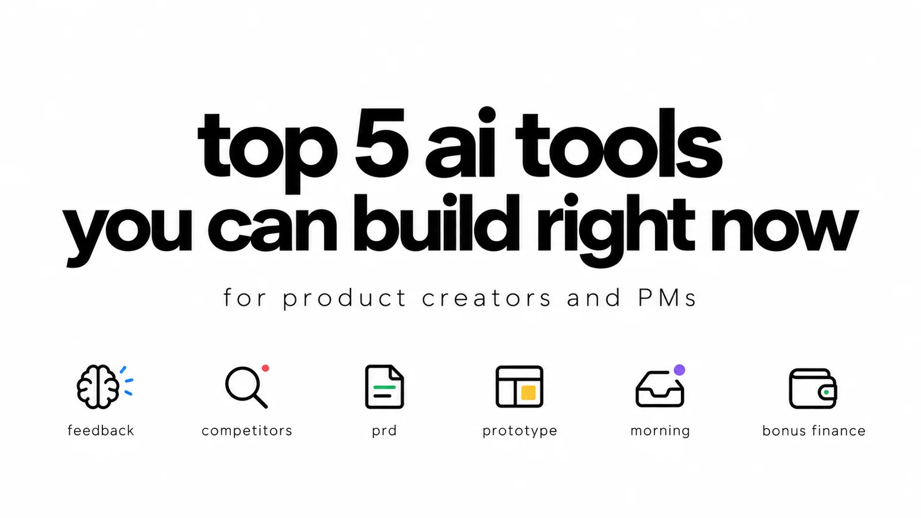
Five small builds and one bonus: what to connect, what to test, and the prompts to use.
Viktor Zaika
Notes:
The full prompts and setup instructions are in the speaker notes for each build. Start with one idea, not the entire stack.

Slide 2
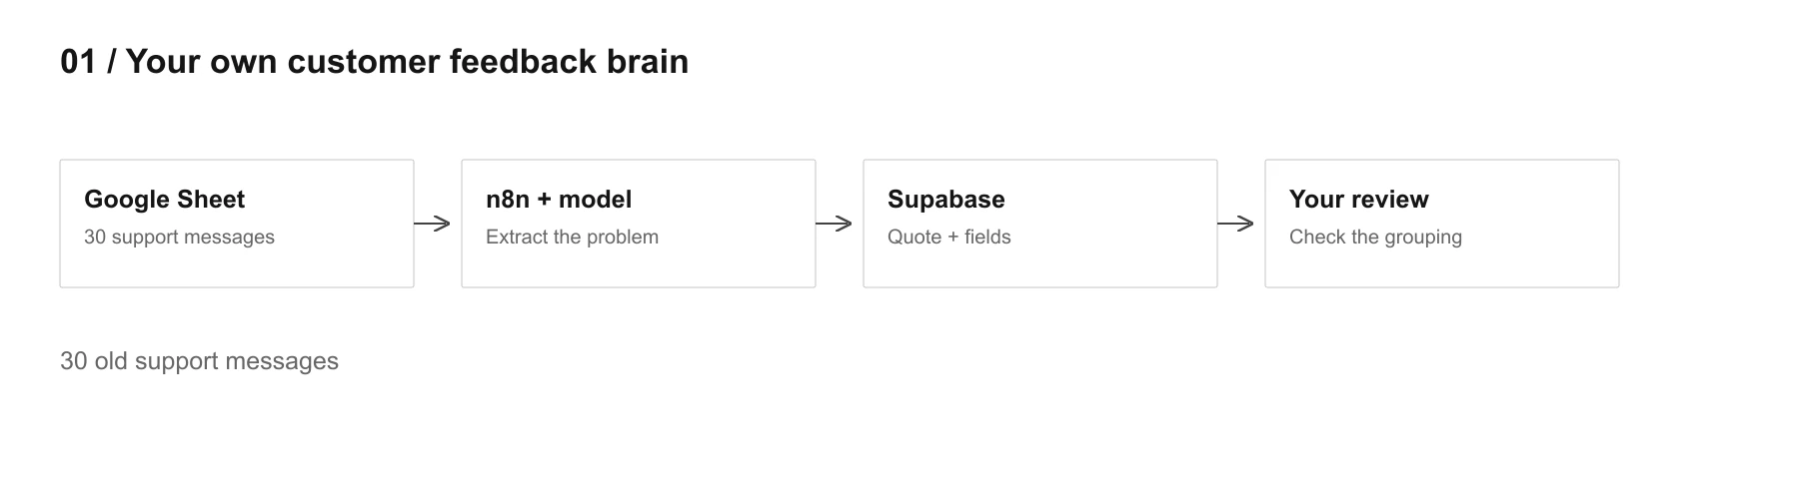
01
Your own customer feedback brain
n8n · Claude or ChatGPT · Supabase
Start with
Original feedback beside a structured problem, feature, severity and confidence.
30 old support messages
Viktor Zaika. Five small AI builds
2
Notes:
How to build it
1. Put 30 messages in a Sheet with a source and stable ID.
2. Use n8n to pass one message at a time to the model. Validate the returned fields before storing them.
3. Save the raw quote and structured fields in Supabase. Inspect the grouping before connecting live sources.
Missing context stays UNKNOWN. Keep source IDs so a second run does not duplicate the same message.
Use this prompt for feedback extraction
Read this customer feedback and extract the underlying problem in plain language.
Return:
product_area
problem
severity from 1 to 5
related_feature if clear
confidence from 0 to 1
If you are not sure, write UNKNOWN.
Do not invent context that is not in the original feedback.
Keep the original customer wording separately.
Supabase tables: https://supabase.com/docs/guides/database/tables
n8n Google Sheets node: https://docs.n8n.io/integrations/builtin/app-nodes/n8n-nodes-base.googlesheets/

Slide 3
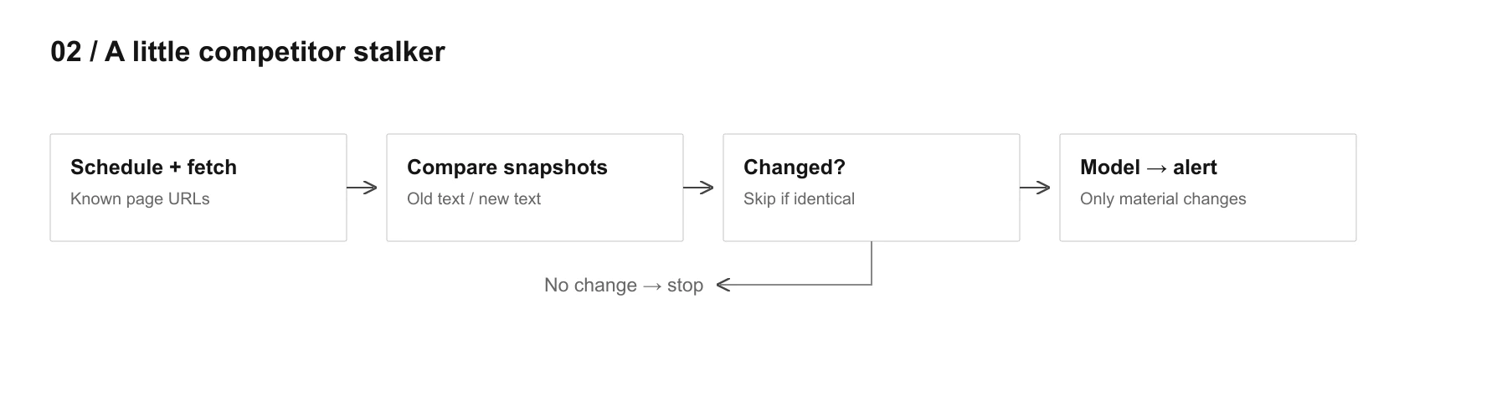
02
A little competitor stalker
n8n · HTTP Request · Supabase · Claude or ChatGPT
Start with
An alert about a material change, with the page link and previous version.
5 competitors, 2 or 3 pages each
Viktor Zaika. Five small AI builds
3
Notes:
How to build it
1. Save a short list of page URLs. Fetch and normalize their text on a schedule.
2. Store each snapshot. Compare with the previous successful fetch before calling the model.
3. Send only changed content for review. Notify on a meaningful change; keep failures separate from change alerts.
A blocked fetch is not a product change. The first fetch creates a baseline, not an alert.
Use this prompt for competitor changes
Compare these two versions of the same competitor page.
Ignore tiny wording changes, formatting changes and irrelevant legal text.
Tell me only if something meaningful changed for product, pricing, positioning, onboarding or target customer.
Return:
changed: true/false
summary
why_it_matters
confidence
n8n HTTP Request: https://docs.n8n.io/integrations/builtin/core-nodes/n8n-nodes-base.httprequest/
n8n Schedule Trigger: https://docs.n8n.io/integrations/builtin/core-nodes/n8n-nodes-base.scheduletrigger/

Slide 4
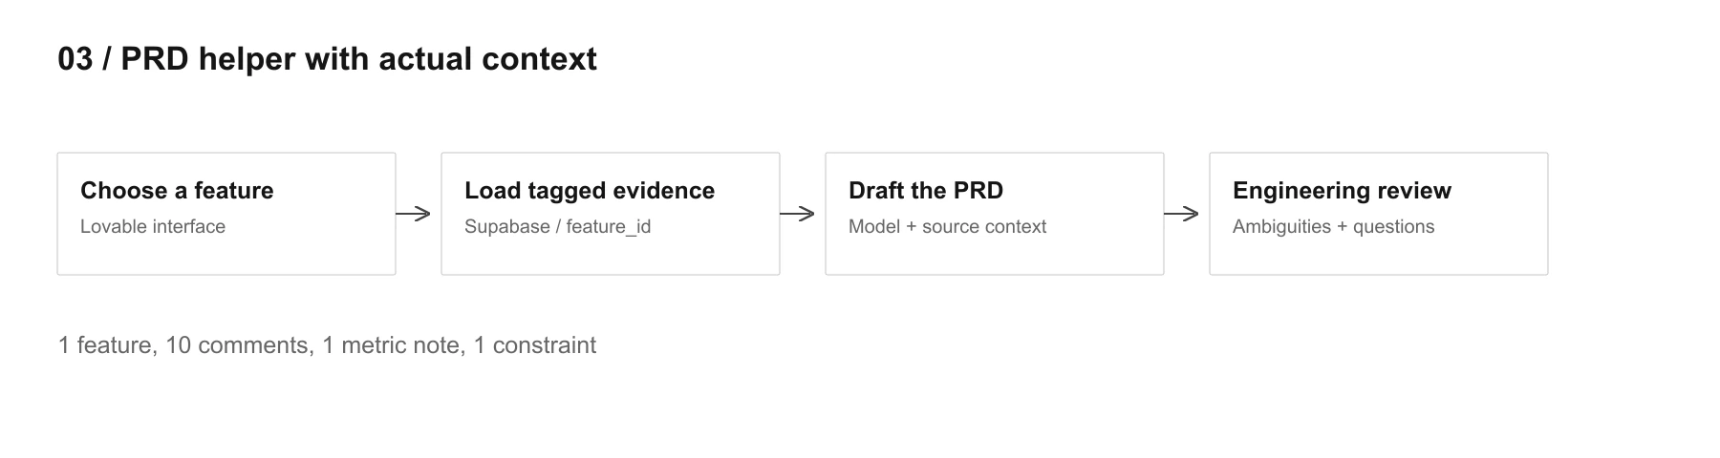
03
PRD helper with actual context
Lovable · Supabase · Claude or ChatGPT
Start with
An evidence-based PRD draft and the questions an engineer still needs answered.
1 feature, 10 comments, 1 metric note, 1 constraint
Viktor Zaika. Five small AI builds
4
Notes:
How to build it
1. Tag feedback, notes and constraints with the same feature_id in Supabase.
2. Choose the feature in a small app. Fetch its evidence and send the context to a server-side model call.
3. Generate a draft, then run the engineering-review prompt. Resolve open questions before treating the PRD as ready.
Tags are enough for the first version. A model-generated draft is not an approved specification.
Use this prompt for the PRD draft
You are drafting a PRD from existing evidence only.
Use the customer feedback, analytics notes and technical constraints below.
Do not invent requirements.
Mark assumptions clearly.
If something important is missing, create an OPEN QUESTION instead of guessing.
Use this prompt for the engineering review
Read this PRD as an engineer who has never seen the feature before.
Point out anything that can be understood in two different ways or cannot be implemented without another decision.
Supabase tables: https://supabase.com/docs/guides/database/tables
Lovable Plan mode: https://docs.lovable.dev/features/plan-mode

Slide 5
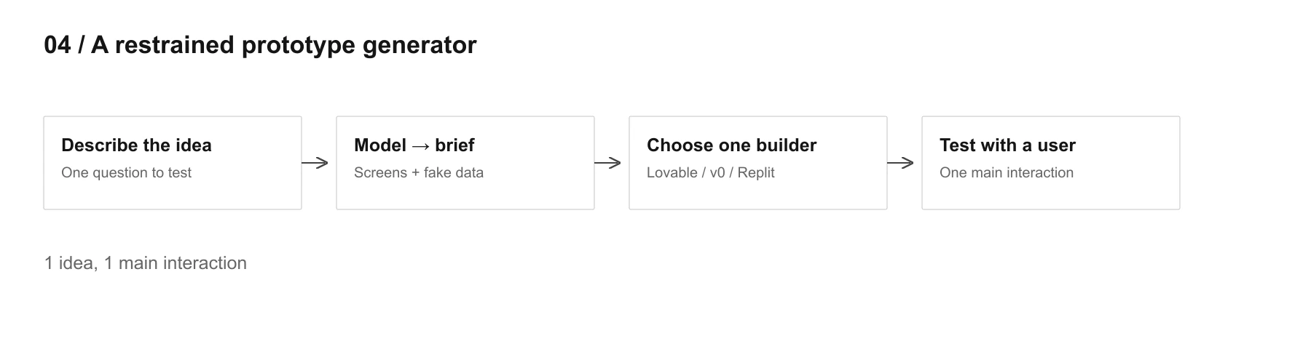
04
A restrained prototype generator
Claude or ChatGPT · Lovable, v0 or Replit
Start with
A narrow brief followed by a clickable prototype using fake data.
1 idea, 1 main interaction
Viktor Zaika. Five small AI builds
5
Notes:
How to build it
1. Describe the idea and the question you want to test.
2. Generate a brief with screens, actions and fake data. Remove features unrelated to that question.
3. Paste the brief into one builder. Click through it with a user and keep the questions the test exposes.
The brief comes first. A prototype is not the full product.
Use this prompt for the prototype brief
I want to test this idea: [IDEA]
Create the smallest possible clickable prototype that would let me test the main interaction with a user.
Use fake data.
Do not add billing, settings, admin panels, notifications, roles or other secondary features unless they are required for the test.
Give me:
screens needed
what happens on each screen
sample fake data
what can stay completely fake
what question this prototype should help me answer
Lovable Plan mode: https://docs.lovable.dev/features/plan-mode

Slide 6
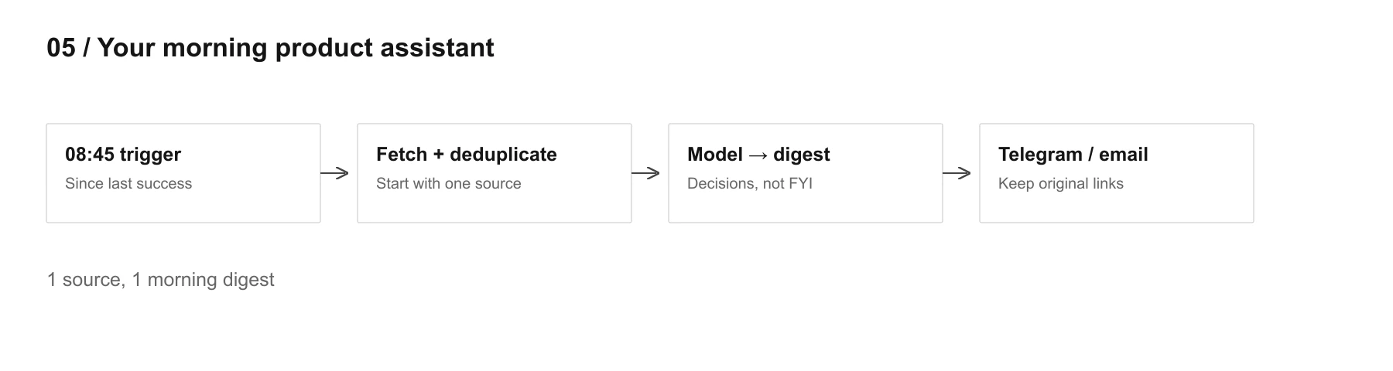
05
Your morning product assistant
n8n · Gmail, Slack or Linear/Jira · a model · one delivery channel
Start with
A short digest with blockers, customer issues and decisions waiting for you.
1 source, 1 morning digest
Viktor Zaika. Five small AI builds
6
Notes:
How to build it
1. Run at 8:45 in your timezone. Fetch items newer than the previous successful run.
2. Deduplicate by source ID. Batch the relevant content for one digest and keep original links.
3. Deliver to the channel you check. After a useful week, add the optional end-of-day diary.
Only advance the saved timestamp after a successful run. You should not lose updates because delivery failed.
Use this prompt for the morning digest
Summarize only things that may affect product decisions today.
Ignore FYI noise and social conversation.
Show:
blockers
customer issues
decisions waiting for me
important changes since yesterday
Keep it short. If nothing important happened, say that.
Use this prompt for the product diary
Based on today's tasks, notes and decisions, tell me what actually changed.
What did we learn?
What assumption got weaker?
What still should NOT be decided yet?
n8n Schedule Trigger: https://docs.n8n.io/integrations/builtin/core-nodes/n8n-nodes-base.scheduletrigger/
n8n Gmail node: https://docs.n8n.io/integrations/builtin/app-nodes/n8n-nodes-base.gmail/

Slide 7
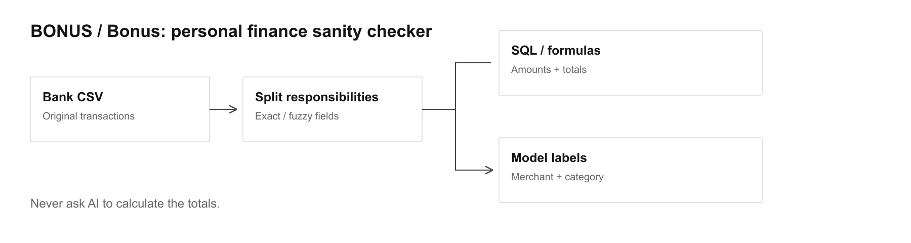
Bonus
Bonus: personal finance sanity checker
Google Sheets or Supabase · n8n · a model
Start with
Exact totals with cleaner merchant names and reviewable spending categories.
2 or 3 months of exported CSV data
Viktor Zaika. Five small AI builds
7
Notes:
How to build it
1. Import the CSV. Preserve the original amounts, dates, currencies and descriptions.
2. Send merchant descriptions for classification. Review uncertain categories and repeated merchants.
3. Use formulas or SQL for totals. Compare like-for-like months; keep currencies separate unless you have explicit exchange rates.
A temporary hold is not automatically a final expense. Recurrence needs transaction history, not one merchant name.
Use this prompt for transaction classification
Classify this transaction based on merchant name and description.
Return:
normalized_merchant
category
recurring: true/false/unknown
confidence
Do not estimate the amount, date or currency. Those come from the original transaction data.
Supabase tables: https://supabase.com/docs/guides/database/tables

Slide 8
The next step
Build the small version first.
Choose one build and check whether the result is useful before adding more sources or features.
Your own customer feedback brain
A little competitor stalker
PRD helper with actual context
30 old support messages
5 competitors, 2 or 3 pages each
1 feature, 10 comments, 1 metric note, 1 constraint
A restrained prototype generator
Your morning product assistant
Bonus: personal finance sanity checker
1 idea, 1 main interaction
1 source, 1 morning digest
2 or 3 months of exported CSV data
Viktor Zaika. Five small AI builds
8
Notes:
Keep the source of truth
Original feedback, previous snapshots, tagged evidence and original transaction fields remain available. Model output adds structure; it does not replace the originals.

