Slide 1

VIKTOR ZAIKA / FIELD NOTES
AI Tips&Tools #1
Test an idea. Build an MVP. Automate the work that keeps stealing your day.
Viktor Zaika. AI Tips&Tools #1

Slide 2
START HERE
Three jobs. Three sensible starting points.
01 / Test demand
02 / Build an MVP
03 / Automate work
Build a landing page and the smallest useful interaction. Deliver the expensive part manually before automating it.
Use a normal web stack when the interface is the hard part. Use a backend app when jobs, APIs, or processing are the product.
Connect tools you already use. Let AI interpret fuzzy inputs, keep exact rules in code, and add memory and approvals.
LOVABLE · SUPABASE · POSTHOG · RESEND
LOVABLE + SUPABASE / REPLIT
N8N OR MAKE · LLM · DATABASE
The goal is to learn sooner, build only what is needed, and spend less time on repeat work.
Viktor Zaika. AI Tips&Tools #1
02

Slide 3
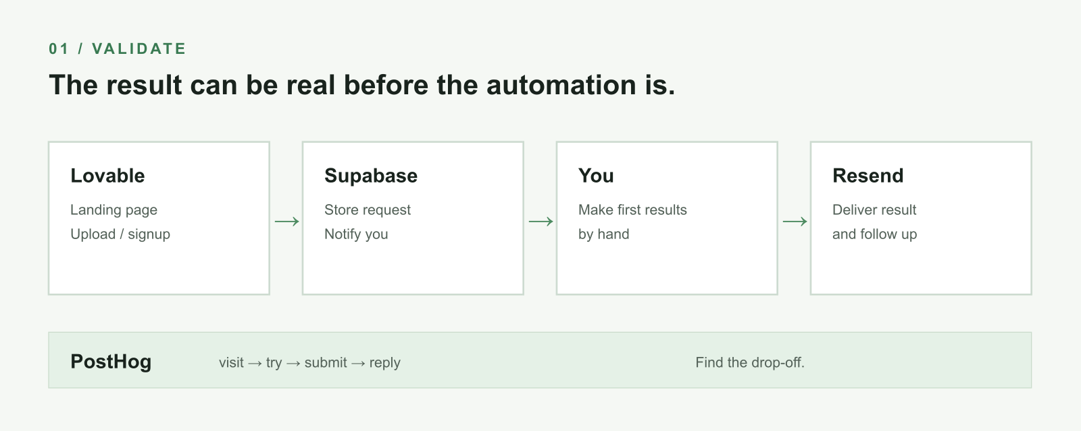
01 / VALIDATE
Test the result before building the machinery.
Source: Lovable, PostHog, Resend docs
Viktor Zaika. AI Tips&Tools #1
03

Slide 4
01 / VALIDATE
Measure the steps, not only the visits.
Manual first
An illustrative funnel
Let someone upload the PDF. Make the first reports yourself. Email them back. Automate the middle only after people want the result.
1,400 visits
382 clicks on Try it
117 forms started
83 forms finished
19 email replies
Source: PostHog funnels
Viktor Zaika. AI Tips&Tools #1
04

Slide 5
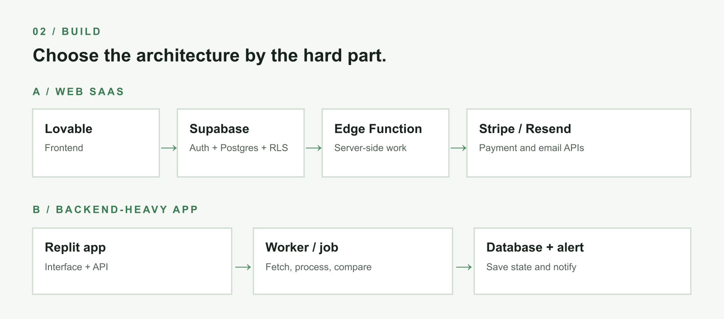
02 / BUILD
Choose by the hard part of the product.
Source: Lovable + Supabase and Replit Agent
Viktor Zaika. AI Tips&Tools #1
05

Slide 6
02 / BUILD
Authentication is not authorization.
Auth identifies Alice
RLS restricts the rows
A login tells the app who made the request. It does not, by itself, decide whether Alice can read Bob’s records.
Database grants and row-level policies decide which data that request may access. Put secret API calls behind a server endpoint or Edge Function.
Stripe secret · Resend key · OpenAI key → server side only
Source: Supabase RLS
Viktor Zaika. AI Tips&Tools #1
06

Slide 7
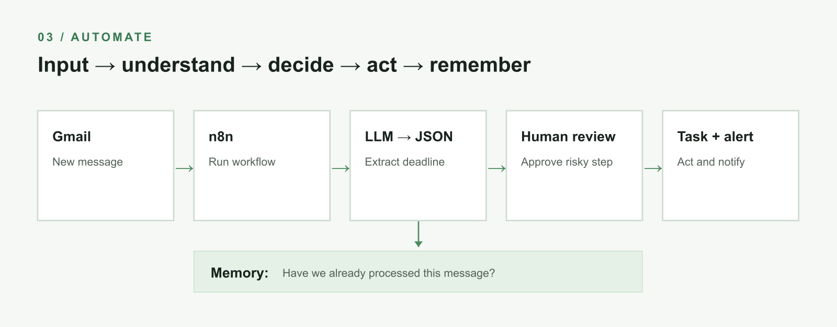
03 / AUTOMATE
Input → understand → decide → act → remember.
Source: n8n Structured Output Parser and human review
Viktor Zaika. AI Tips&Tools #1
07

Slide 8
03 / AUTOMATE
Pipelines that save real time.
Research
Meetings
RSS / sites → dedupe → LLM ranks → one digest
Transcript → decisions / actions → tasks + summary
Content
Online observability
Telegram idea → Notion → research questions → wait
Alerts / reviews → dedupe → classify → notify
An automation does not need to write the post to be useful.
Viktor Zaika. AI Tips&Tools #1
08

Slide 9
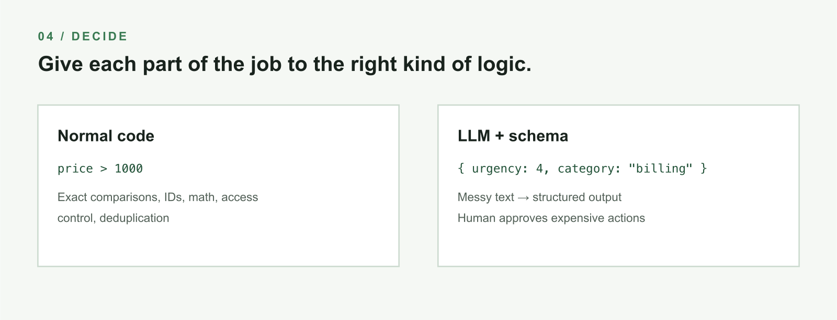
04 / DECIDE
Use AI for messy language. Use code for exact rules.
Source: n8n Structured Output Parser
Viktor Zaika. AI Tips&Tools #1
09

Slide 10
05 / REMEMBER
One table can make a workflow feel smarter.
source_url
hash
first_seen
summary
topic
Before expensive work
Have I already seen this URL or hash?
Yes → skip it.
No → process, save, and notify.
Store enough state to avoid repeat work.
Source: Supabase Postgres overview
Viktor Zaika. AI Tips&Tools #1
10

Slide 11
KEEP THESE
The three stacks to remember.
Test whether anybody cares
Lovable + Supabase + PostHog + Resend
Build something usable
Lovable + Supabase, or Replit when backend logic is the interesting part
Automate your own work
n8n + tools you already use + LLM + a small database for memory
Viktor Zaika. AI Tips&Tools #1
11

Slide 12
USE THIS PROMPT FOR VALIDATE AN IDEA WITHOUT BUILDING THE COMPANY
Validate an idea without building the company
I want to validate this product idea: [DESCRIBE IDEA].
I do NOT want to build the full product yet.
Design the smallest possible validation architecture using Lovable, Supabase, PostHog and Resend.
Explain:
1. what should actually be built
2. what can be manually faked behind the scenes
3. what data should be stored in Supabase
4. which PostHog events I should track
5. what conversion funnel I should create
6. what emails should be sent through Resend
7. what would count as enough evidence to proceed to an MVP
Keep the architecture intentionally simple. Do not introduce extra services unless there is a very good reason.
Viktor Zaika. AI Tips&Tools #1
12

Slide 13
USE THIS PROMPT FOR CHOOSE THE SMALLEST TECHNICALLY SANE MVP
Choose the smallest technically sane MVP
I want to build this MVP: [DESCRIBE PRODUCT].
Help me choose between:
A. Lovable + Supabase
B. Replit
C. a combination of both
Do not choose based on which tool you like more. Choose based on the actual technical requirements.
First identify:
1. frontend requirements
2. authentication
3. database entities and relationships
4. authorization rules
5. external APIs
6. background or long running jobs
7. file storage
8. payments
9. transactional email
10. analytics
Then propose the smallest architecture that is still technically sane.
Explicitly tell me which operations must happen server side and which secrets must NEVER be exposed in the frontend.
If using Supabase, propose the tables and RLS rules as well.
Viktor Zaika. AI Tips&Tools #1
13

Slide 14
USE THIS PROMPT FOR SEPARATE RULES, AI, APPROVAL, AND MEMORY
Separate rules, AI, approval, and memory
I currently do this manually:
[DESCRIBE THE PROCESS IN NORMAL HUMAN LANGUAGE]
Design an automation for it.
Separate the workflow into:
deterministic steps that should use normal logic,
fuzzy steps where an LLM actually makes sense,
actions that should require human approval,
state that needs to be stored so the workflow remembers what it already did.
Prefer n8n and services I already use. Keep the number of moving parts as small as possible.
For every LLM step, define the exact structured JSON output it should return.
Also tell me how this workflow can fail and what I should log so I can debug it later.
Viktor Zaika. AI Tips&Tools #1
14

Slide 15
FURTHER READING
Product documentation behind the diagrams.
Lovable + Supabase
Replit Agent
docs.lovable.dev/integrations/supabase
docs.replit.com/features/agent/overview
Supabase RLS
n8n structured output
supabase.com/docs/guides/database/postgres/row-level-security
docs.n8n.io/integrations/builtin/cluster-nodes/sub-nodes/n8n-nodes-langchain.outputparserstructured
Supabase Edge Functions
n8n human review
supabase.com/docs/guides/functions
docs.n8n.io/advanced-ai/human-in-the-loop-tools
PostHog funnels + replay
Make integrations
posthog.com/docs/product-analytics/funnels
www.make.com/en/integrations
Resend Email API
resend.com/features/email-api
Viktor Zaika. AI Tips&Tools #1
15

