Slide 1
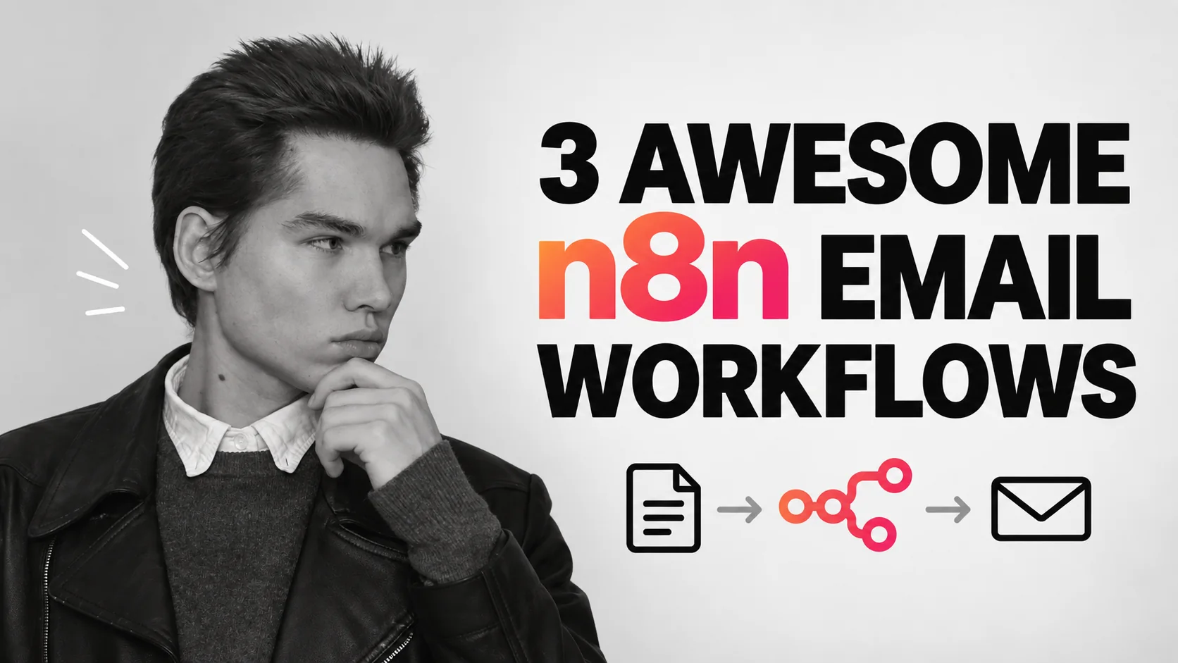
Viktor Zaika

Slide 2
CHOOSE THE JOB
What should happen to the email?
01
02
03
Too many incoming emails
Checking the inbox too often
Documents buried in messages
→
→
→
Sort by category and prepare drafts
Get one prioritized daily digest
Store PDFs and index their fields
Viktor Zaika
02

Slide 3
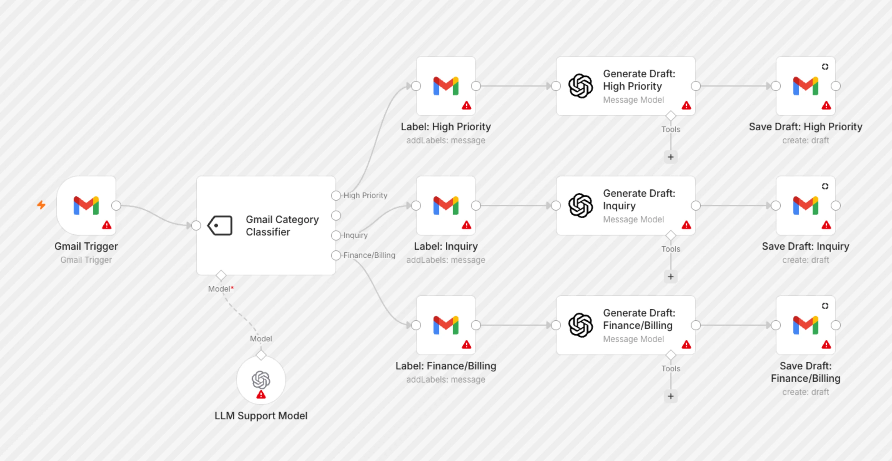
01 / ACTUAL N8N TEMPLATE
Sort emails and draft replies
Gmail → classify → label → draft
Full-resolution n8n template by Supira Inc. ↗
Viktor Zaika
03
Notes:
A classifier chooses a category. The Switch routes it to a label and, where appropriate, a draft. You review before sending.
Notice the separate label and draft branches. Red warning triangles indicate credentials to configure.
https://n8n.io/workflows/8426-gmail-email-classifier-with-gpt-4-auto-generated-draft-replies/
Use this prompt for sorting emails and drafting replies:
Analyze this incoming email.
Return ONLY valid JSON:
{
"category": "urgent | sales | support | invoice | newsletter | personal | ignore",
"priority": "high | medium | low",
"needs_reply": true,
"summary": "one short sentence",
"draft_reply": "reply text or null"
}
Rules:
Use "urgent" only when there is a clear deadline, serious problem or something blocking work.
Use "invoice" for invoices, payment requests, receipts and billing-related emails.
Use "newsletter" for promotional or mass-distributed content.
Set needs_reply to false for newsletters, receipts, automated notifications and emails that do not expect a response.
If a reply is needed, write a short natural reply matching the sender's tone.
Do not invent prices, dates, promises or facts.
If information is missing, write [NEEDS INPUT] inside the draft.

Slide 4
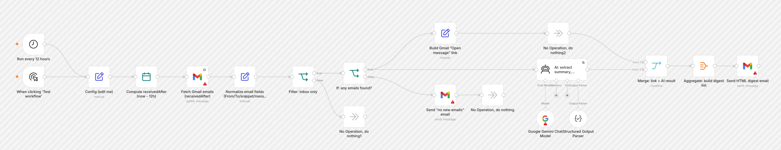
02 / ACTUAL N8N TEMPLATE
Get one useful email digest
Schedule → recent email → AI → digest
Full-resolution n8n template by Mohammed Aljer ↗
Viktor Zaika
04
Notes:
A schedule collects recent messages. AI identifies the few that need attention, then one digest links back to the originals.
The real template has extra routes for an empty inbox and for building direct links to messages.
https://n8n.io/workflows/13126-summarize-gmail-emails-with-gemini-and-send-an-html-action-digest/
Use this prompt for creating an actionable digest:
Create a short actionable digest from these emails.
Group them into:
1. URGENT
2. NEEDS REPLY
3. ACTION REQUIRED
4. FYI
5. NEWSLETTERS / PROMOTIONS
For each important email return:
{
"sender": "",
"subject": "",
"summary": "",
"action": "",
"priority": "high | medium | low"
}
Rules:
Keep summaries to one sentence.
Extract concrete actions when possible.
Include deadlines only when explicitly mentioned.
Do not include routine automated notifications unless they contain an error, payment problem, security warning or other issue requiring attention.
For newsletters and promotions, only return the total count unless something looks unusually relevant.
Sort important emails by priority.

Slide 5
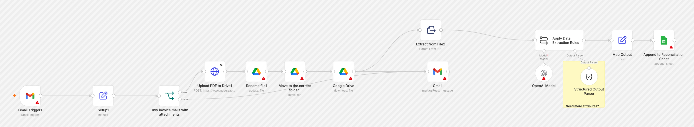
03 / ACTUAL N8N TEMPLATE
Process invoices and attachments
Gmail → PDF → extraction → Drive + Sheets
Full-resolution n8n template by Juan Carlos Cavero Gracia ↗
Viktor Zaika
05
Notes:
The PDF goes to Drive. Extracted fields and the Drive link go to Sheets, so the original file and searchable data stay together.
Follow the original attachment into Drive, then the extraction path into a Sheets row.
https://n8n.io/workflows/3016-invoices-from-gmail-to-drive-and-google-sheets/
Use this prompt for extracting attachment details:
Analyze this email and attached document.
Return ONLY valid JSON:
{
"document_type": "invoice | receipt | contract | report | other",
"company": "",
"invoice_number": "",
"invoice_date": "",
"due_date": "",
"currency": "",
"amount": null,
"description": "",
"suggested_filename": ""
}
Rules:
Never guess missing values.
Use null when a value cannot be found.
Dates should use YYYY-MM-DD.
Amount must contain numbers only.
suggested_filename format:
YYYY-MM-DD_Company_DocumentType_InvoiceNumber.pdf
Remove characters that are unsafe in filenames.

Slide 6
BEFORE ACTIVATING
Test with a small batch first.
01
Credentials
Connect Gmail, AI and any Drive or Sheets accounts.
02
Data shape
Check the JSON fields and Switch routes.
03
Human review
Read drafts and check invoice amounts before acting.
Full prompts are in the relevant slide notes and in the companion PDF.
Viktor Zaika
06

